Slide 1
Distributed Systems & Big Data 2023/24
Etna events notifier
Studente: Francesco Pandolfo
Matricola: 1000008982

Slide 2


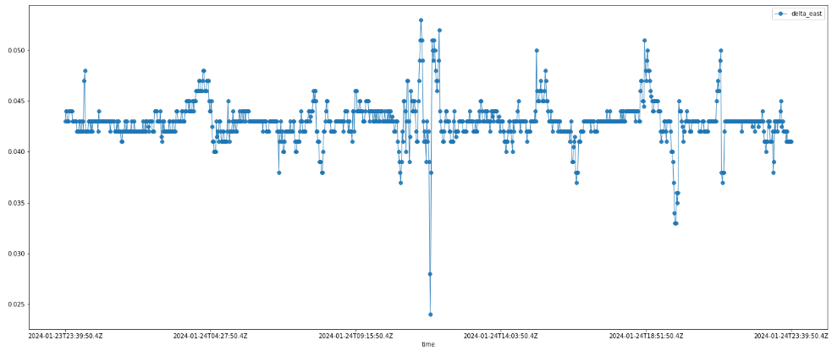






VPN
User Interface
get-time-series
8001
8080 /gettimeseries
/query
createQuery_Influxdb
dataframe
JsonRawToJsonDataFrame
8086
/query
users-manager
JSON raw
8002
8080 /consumers
/register
/all
/get {username}
/delete {username}
- consumers
- subscriptions
3306
/subscriptions
/register
/all
/unsubscribe {id}
30sec
processSubscriptions
publish
9092
3306
kafka
- notifications
topics:
- station-threshold-mintime
- station-threshold-mintime [DATA-OK]
- usersmanager_LOG
- notifier_LOG
notifier
subscribeTopics
subscribe
10sec
checkNewSubscriptions
station-threshold-mintime
emailService

Slide 3

VPN
User Interface
get-time-series
8001
8080 /gettimeseries
/query
createQuery_Influxdb
custom exporter
JsonRawToJsonDataFrame
dataframe
8086
/query
users-manager
JSON raw
8002
8080 /consumers
/register
/all
/get {username}
/delete {username}
- consumers
- subscriptions
3306
/subscriptions
/register
/all
/unsubscribe {id}
30sec
processSubscriptions
publish
custom exporter
9092
3306
kafka
- notifications
topics:
- station-threshold-mintime
- station-threshold-mintime [DATA-OK]
- usersmanager_LOG
- notifier_LOG
notifier
cAdvisor
subscribeTopics
subscribe
10sec
checkNewSubscriptions
station-threshold-mintime
emailService

Slide 4

VPN
User Interface
get-time-series
8001
8080 /gettimeseries
/query
createQuery_Influxdb
dataframe
JsonRawToJsonDataFrame
8086
/query
users-manager
JSON raw
8002
8080 /consumers
/register
/all
/get {username}
/delete {username}
- consumers
- subscriptions
3306
/subscriptions
/register
/all
/unsubscribe {id}
9090
30sec
processSubscriptions
publish
8005
9092
8003
3306
kafka
- notifications
topics:
- station-threshold-mintime
- station-threshold-mintime [DATA-OK]
- usersmanager_LOG
- notifier_LOG
notifier
sla-manager
subscribeTopics
/consumers
subscribe
/discoveryJobs /getState
/discoveryMetrics /violations
/unsubscribe {id} /violations/prob.
/metrics
/register
/delete
/all
/get
10sec
checkNewSubscriptions
station-threshold-mintime
8004
emailService
notifications

